Slide 1

Exam AZ-303: Microsoft Azure Architect Technologies Crash Course
Tim Warner

Slide 2


Tim Warner
Based in Nashville, TN, US
MCT, MVP
Twitter: @TechTrainerTim
Badge: TechTrainerTim.com

Slide 3
Day 1 of 2 Agenda
Introduction
Implement and Monitor Azure Infrastructure
Implement Cloud Application

Slide 4
Day 2 of 2 Agenda
Implement Governance and Security Solutions
Implement and Manage Data Platforms
Exam AZ-303 Strategy

Slide 5
Course Materials
timw.info/az303

Slide 6
Expectations
This is an expert certification, so we move quickly and assume intermediate-level Azure skills
PLEASE REVIEW THE RECORDINGS
10-minute break at midpoint
I’m here to answer your questions – take advantage of this!
Use the Q&A panel

Slide 7
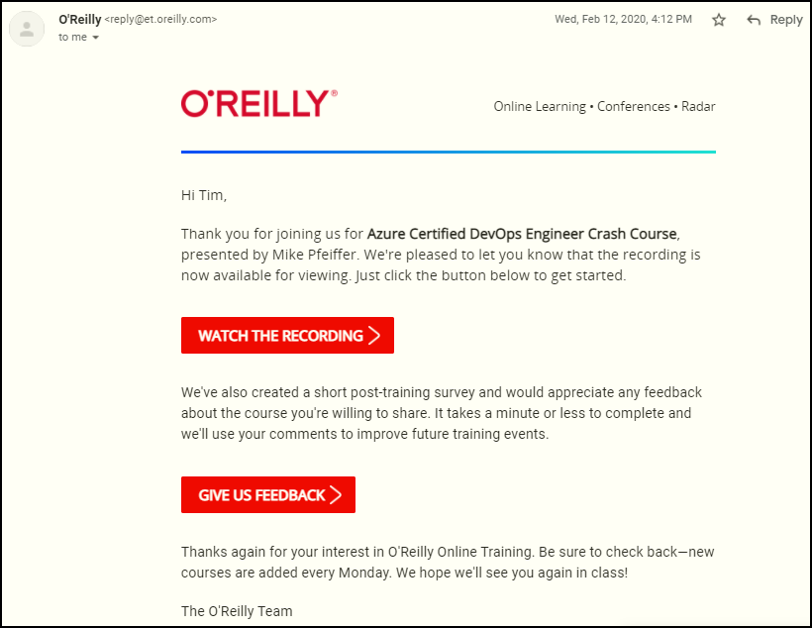
Session Recordings

Slide 8

Session Recordings

Slide 9

Session Recordings

Slide 10

Session Recordings

Slide 11


Session Recordings

Slide 12
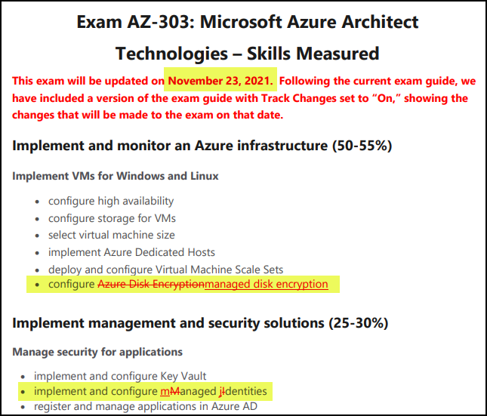
Azure Architect Cert Latest Changes

Slide 13
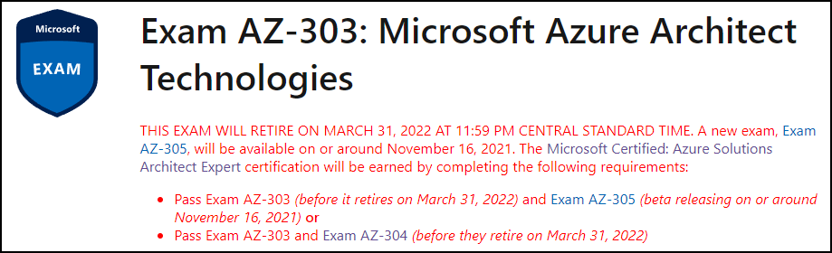
Azure Architect Cert Latest Changes
timw.info/qwb

Slide 14
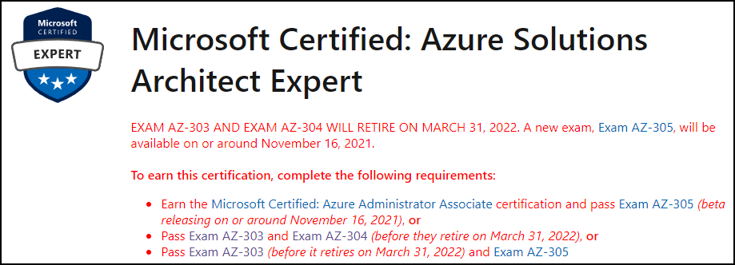
Azure Architect Cert Latest Changes
timw.info/qwb

Slide 15
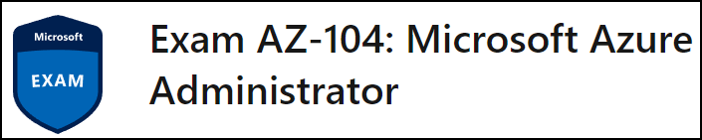
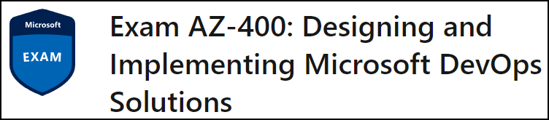
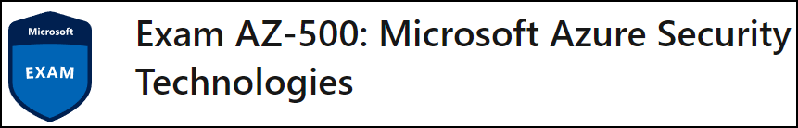
Related Certification Exams

Slide 16

Tim's Certification Study Model

Slide 17
Thank you!
Course materials: timw.info/az303
Twitter: @TechTrainerTim
Work: timw.info/ps
Web: TechTrainerTim.com

Slide 18
Azure Compute

Slide 19
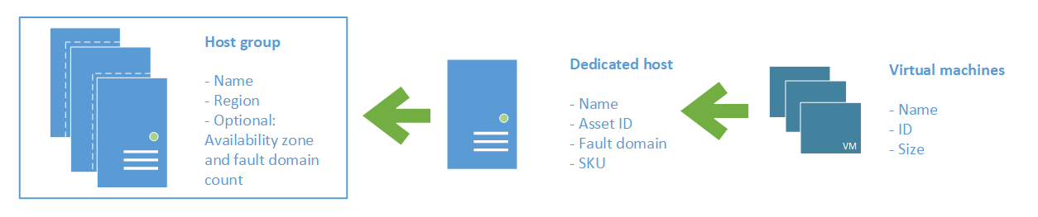
Azure VM Dedicated Host

Slide 20
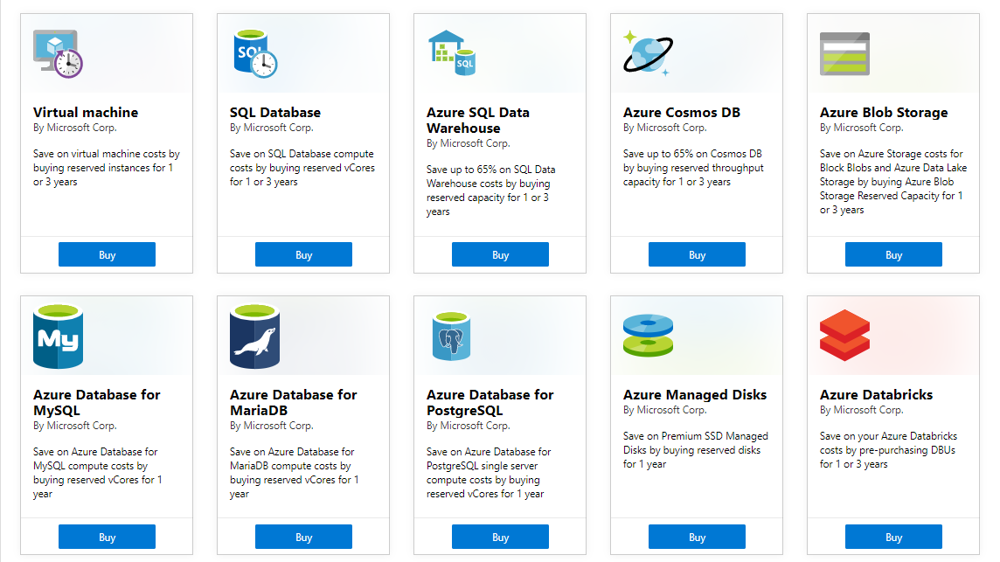
Azure Reservations

Slide 21

VM Scale Sets

Slide 22
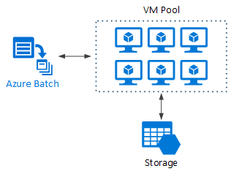
Azure Batch

Slide 23

Availability Set

Slide 24

Availability Zone

Slide 25






Azure App Service
Web Apps
Web Apps for Containers
API Management
Functions
Logic Apps

Slide 26


Docker Lifecycle
https://timw.info/89a04

Slide 27



Running Containers in Azure
Azure Container Instances
Azure Container Registry
Azure Kubernetes Service (AKS)

Slide 28
Load Balancing

Slide 29

VM Networking

Slide 30

Load Balancing

Slide 31

VNet Peering

Slide 32

Hybrid Networking

Slide 33

Network Virtual Appliance

Slide 34

Azure Load Balancer

Slide 35

Application Gateway

Slide 36
Authentication

Slide 37

Azure Subscriptions

Slide 38

Azure Management Scopes
/ Tenant root
Inheritence:
RBAC
Policy
No inheritence:
Tags

Slide 39

Hybrid Identity

Slide 40

Passthrough Authentication

Slide 41

Seamless Single Sign-on

Slide 42
Azure Storage

Slide 43
Storage Account Replication
1
3
3
2
LRS
ZRS

Slide 44
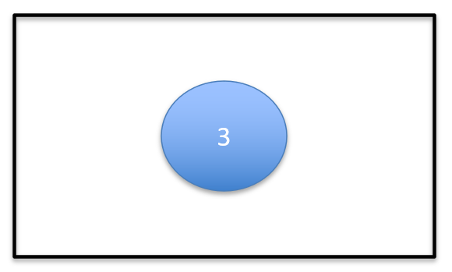
Storage Account Replication
1
3
1
3
2
2
GRS / RA-GRS

Slide 45
Storage Account Replication
1
3
1
3
2
2
GZRS / RA-GZRS

Slide 46

Traffic Manager

Slide 47

Front Door Service

Slide 48
Governance

Slide 49

Tenant vs. Subscription

Slide 50
Azure Management Scopes
/ Tenant Root

Slide 51
App Architecture

Slide 52


Docker Container Lifecycle
https://timw.info/3635f

Slide 53

Event Architecture

Slide 54
Data Platform

Slide 55

Always Encrypted

Slide 56
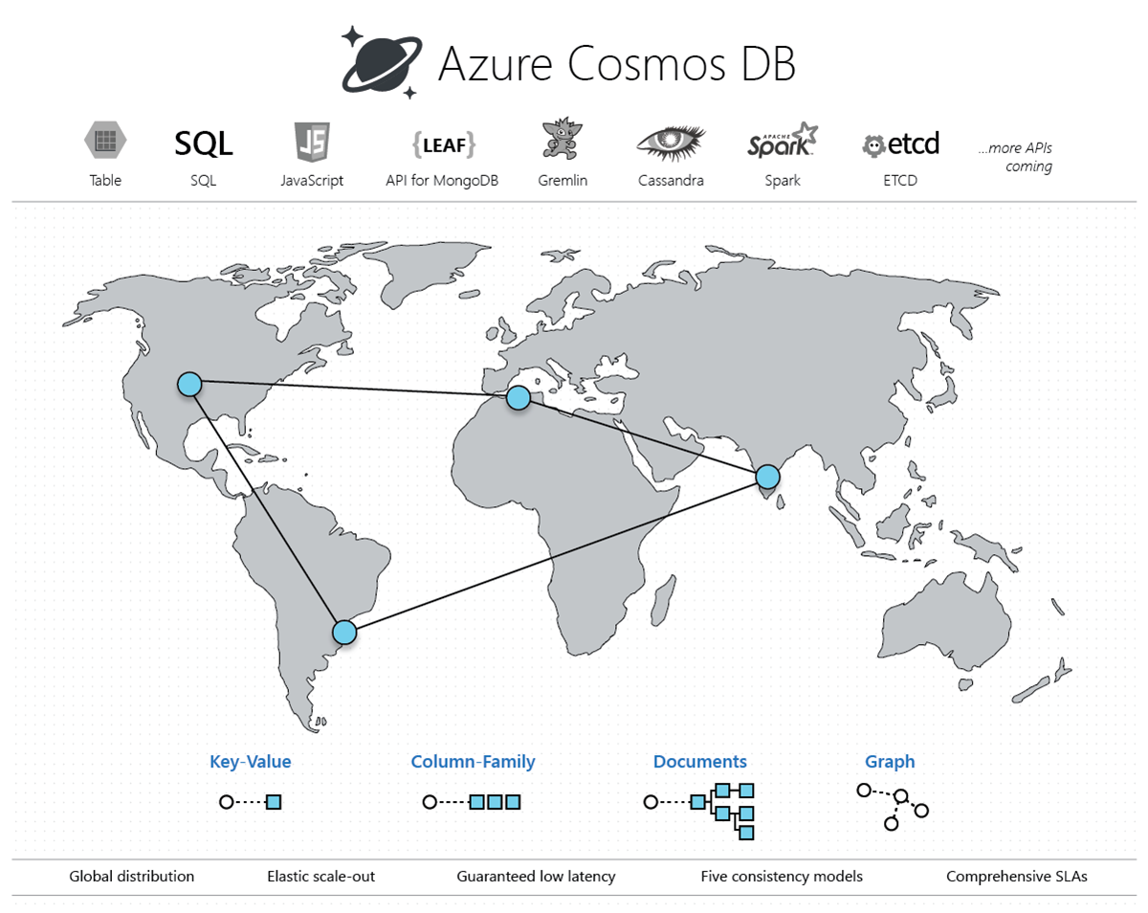
Cosmos DB

Slide 57
Exam AZ-303 Item Types

Slide 58

Multiple Choice

Slide 59

Multiple Choice

Slide 60
Repeated Scenario
You need to move an Azure VM to another hardware host.
Solution: You redeploy the VM.
Does this solution meet the goal?
Yes
No

Slide 61
Repeated Scenario
You need to move an Azure VM to another hardware host.
Solution: You create a proximity placement group.
Does this solution meet the goal?
Yes
No

Slide 62

Select and Place

Slide 63

Build List and Reorder

Slide 64
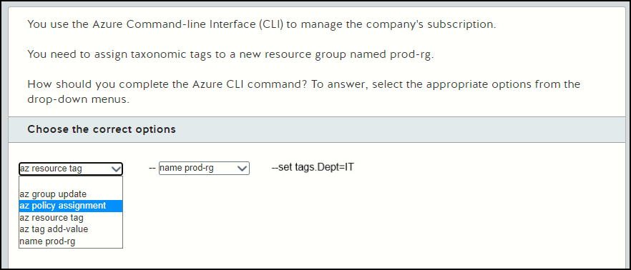
Active Screen

Slide 65

Case Study

Slide 66






Performance-Based Lab

Slide 67
Microsoft Online Testing

Slide 68
Microsoft Online Testing Process
timw.info/online

Slide 69

Microsoft Online Testing Process

Slide 70

Microsoft Online Testing Process

Slide 71

Microsoft Online Testing Process

Slide 72

Microsoft Online Testing Process

Slide 73

Microsoft Online Testing Process

Slide 74

Microsoft Online Testing Process

Slide 75

Microsoft Online Testing Process

Slide 76
AZ-303 Exam Strategy
Focus your skills accordingly:
60 percent Azure portal
20 percent Azure PowerShell
10 percent Azure CLI
10 percent KQL
Expect performance-based labs, but be thankful if you don't see 'em

